Slide 1


Introduction to Business Analytics, Cognos and SPSS
Matthew Robinson – IBM Business Analytics Specialty Architect
Matthew.robinson@uk.ibm.com
+44(0)7810 554642

Slide 2
Agenda
What is Analytics?
Cognos Business Intelligence (BI)
SPSS Modeler
Summary
Why are organisations looking at Analytics?
Scope
What is it?
Overview of capabilities
How does it work?
What is it?
Overview of SPSS
Demonstration
Demonstration
Use Cases
Information

Slide 3
Agenda
What is Analytics?
Cognos Business Intelligence (BI)
SPSS Modeler
Summary
Why are organisations looking at Analytics?
Scope
What is it?
Overview of capabilities
How does it work?
What is it?
Overview of SPSS
Demonstration
Demonstration
Use Cases
Information

Slide 4
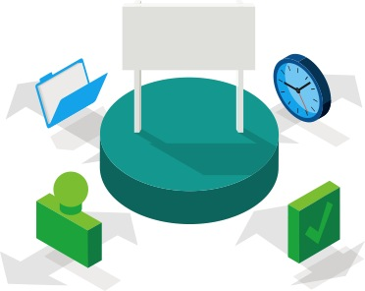
ANALYTIC-DRIVEN ORGANIZATIONS are distinguished by their ability to leverage …
All information
All information
Transaction data
Application data
Machine data
Stream data
Social data
Enterprise content
All perspectives
  Past (historical, aggregated)
  Present (real-time)
  Future (predictive)
At the point
of impact
All people
  All departments
  Experts and non-experts
  Executives and employees
  Partners and customers
All decisions
  Major and minor
  Strategic and tactical
  Routine and exceptions
  Manual and automated
Notes:
What we have seen from thousands of engagements is that organizations with a high-AQ:
Exploit all information. They are integrating existing and new sources of information to unlock new insights, identifying new opportunities and delivering new business value.
They leverage all perspectives by analyzing available data to assess WHAT HAPPENED, understand WHAT IS HAPPENING NOW, and predict WHAT WILL HAPPEN in the future.
They empower all people with analytics by putting analytics in the hands of everyone using integrated tools tailored to serve the needs of the enterprise, workgroups and individuals.
And they are embedding analytics into all decisions that enable fact-based decision-making at the point of impact.
Moving on…
4

Slide 5

…and focusing on high-value initiatives in core BUSINESS AREAS
1
Examples
Customers
  Advanced client segmentation
  Leveraging customer sentiment analysis
  Reducing customer churn
2
Enabling continuous planning and forecasting
Automating financial and management reporting
Improving visibility, insight and control
Finance
3
Making risk-aware decisions
Managing financial and operational risks
Reducing the cost of compliance
Risk
4
Optimizing the supply chain
Deploying predictive maintenance capabilities
Transform threat & fraud identification processes
Operations
Notes:
As we touched on earlier, outperforming organizations often start in one of four high-value areas.
The first is in the area of customer analytics
In the current hyper-competitive environment, the mandate to acquire new customers, keep profitable existing customers, and grow their spend has never been higher.
To help do that organizations are using Customer analytics for advanced client segmentation so they can market to customers as individuals. They are analyzing the social media sphere as well as other unstructured data to gain an improved understanding of customer sentiment to take actions that improve customer loyalty and decrease customer churn.
The second area clients are focusing on is leveraging analytics to transform financial processes
Organizations are focused on enabling rolling plans, improving their forecasting and budgeting process, and responding to changing market dynamics. They are also looking to automate the financial close process and delivering real time dashboards so they have their fingers on the pulse of the entire business.
The third is using analytics to make more risk aware decisions
In the post-2008 era of increasing regulation, oversight, and demands of transparency, organizations are using analytics to make risk-aware decisions, managing both financial and operational risk, and dramatically reducing the cost of compliance.
And finally in the area of operational efficiency
Organizations are using analytics to drive the next wave of operational efficiencies – optimizing their supply chains, identifying threats and reducing fraud, and most recently in the emerging area of predictive maintenance which is using analytics to predict when maintenance is needed so that it can be done before failure – not after.
Let’s spend a little time discussing each of the four high value business areas and how IBM can help.
5

Slide 6
Integration is fundamental to the success of Business Analytics
IBM Business Analytics
Deliver Actionable Insight
How are we doing?
Why?
What should we be doing?
Immediate Insights to Business Performance
Deeper Analysis of Trends & Patterns
Foresight to Plan & Allocate Resources
Scorecards
Dashboards
Reports
Real-Time Monitoring
Ad-hoc Query
Analysis and Exploration
Trend and Statistical Analysis
Data Mining
What-If Analysis
Predictive Analysis
Consolidate Information

Slide 7
Smarter Analytics Maturity Model
Reactive to Prescriptive to Predictive to Cognitive
Predict / Prescribe Best that can happen?
Optimization
Views of What will happen next?
Predictive
Modelling
What if theses trends continue?
Forecasting
Analytics
Why is this happening?
Statistical
Analysis
Competitive Advantage
Alerts
What actions are needed?
Drill down
Query
Exact root cause and ID of the problem?
Ad Hoc Reports
Access & Reporting
How many, how often, who, & where?
Dash/KPI
What just happened and why?
Smarter Analytics
Notes:
7
7
There’s always been this goal of achieving pervasive BI – or reaching a broader number of users in an organization that we currently do. This is something that every vendor strives for – how can we reach more users? Cognos 10 extends the number and type of users we can reach but more importantly, more people can interact with information in more ways … with expanded mobile device support, or disconnected interActive Report, or easier, more compelling self service workspace that integrates everything they need for business analytics in one place. Whether it’s a less skilled user, a user who is often on the road, a user who is brought into a collaboration to reach a decision and clicks on a link to a BI workspace … we can now reach a broader range of users than we ever could before.
The reason you see Active Report, Real-Time Monitoring and Mobile highlighted in red here is because these are the three areas we are going to focus on in the Consumers section.
Additional notes:
---------------------------------
“”Pervasive BI” continues to be more of a vision rather then a reality. BI adoption hasn’t budged since we first began assessing this point in 2005. The percentage of employees using BI in 2007 was 25% and was 24% in 2009. Survey respondents perceived potential for BI (assuming unlimited budget) also continues to be flat, at 56%. – Source BI Scorecard Survey (Cindi Howson)

Slide 8
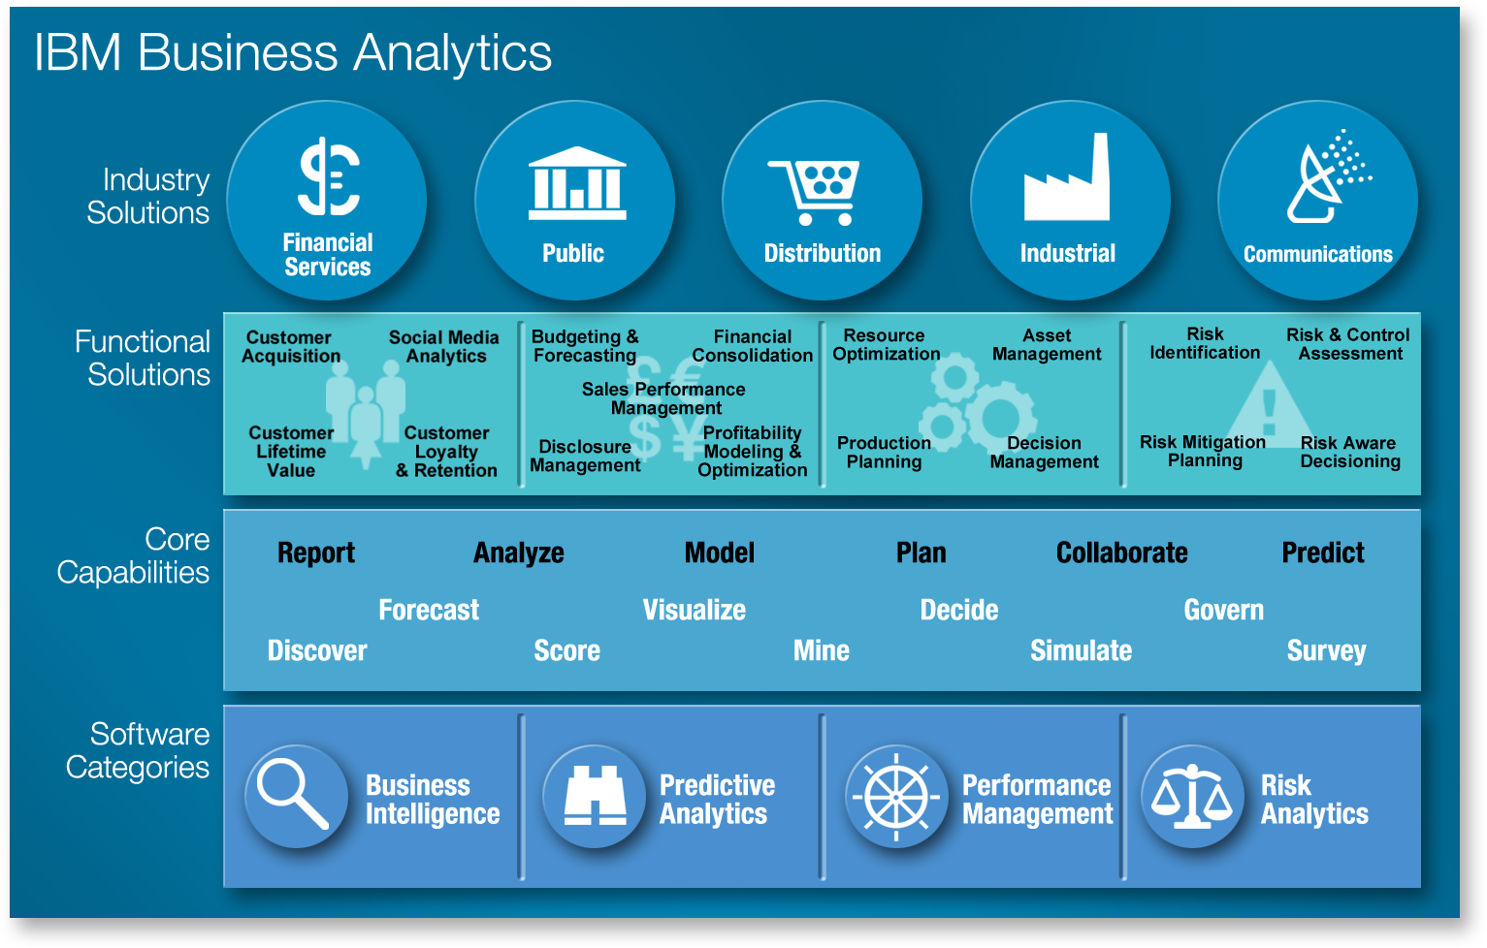
The IBM Business Analytics portfolio
Notes:
Represented here is the full breadth of the IBM Business Analytics portfolio. The portfolio has a range of solutions built to uncover insights for specific industries such financial services, public sector, distribution, industrial and communications, as well as deliver insights for the four high-value functional solutions that we just covered.
These solutions leverage a range of rich Business Analytics capabilities enabled by 4 core product areas. …
Business Intelligence
Predictive Analytics
Performance Management and
Risk Analytics
And these solutions and capabilities have been designed to leverage a foundation of trusted information built upon rich data management capabilities and optimized systems from IBM.

Slide 9
Agenda
What is Analytics?
Cognos Business Intelligence (BI)
SPSS Modeler
Summary
Why are organisations looking at Analytics?
Scope
What is it?
Overview of capabilities
How does it work?
What is it?
Overview of SPSS
Demonstration
Demonstration
Use Cases
Information

Slide 10
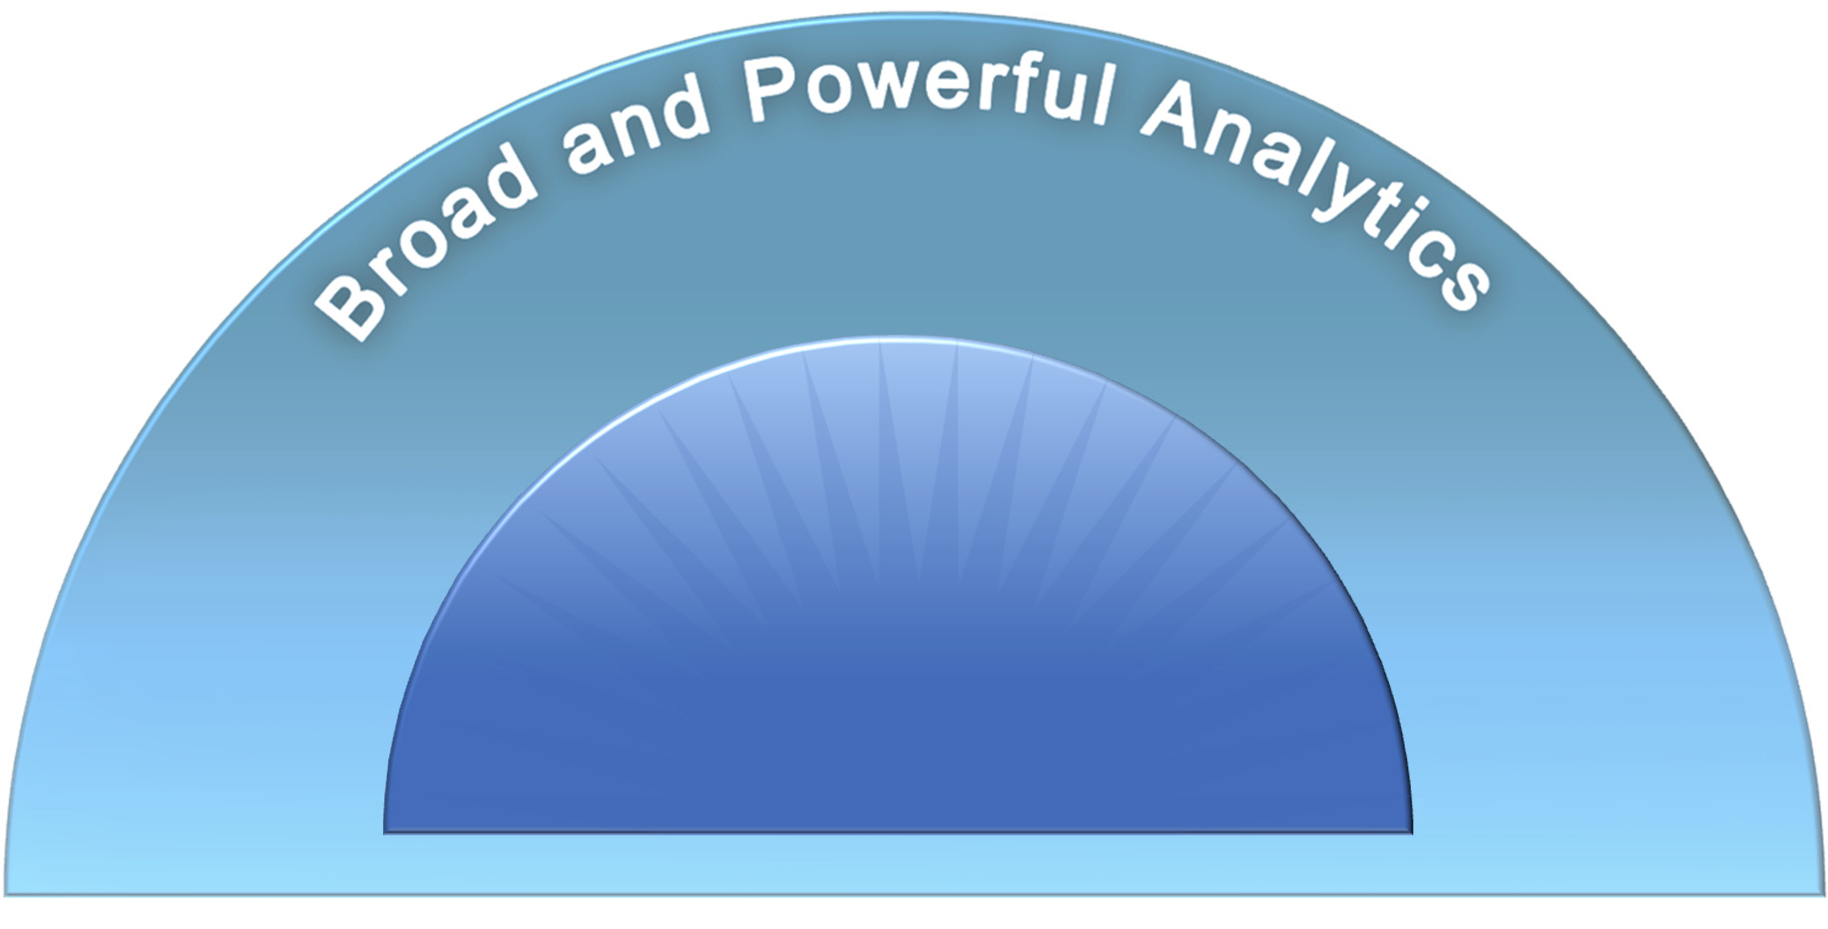
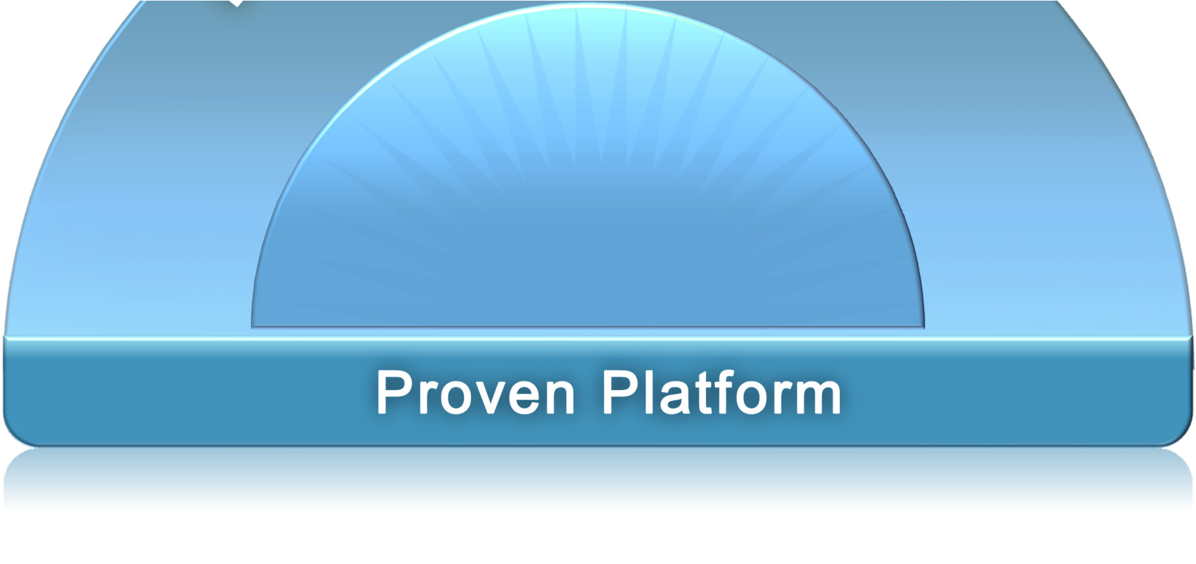








What is Cognos Business Intelligence?
Ad-hoc
Query
Real-Time
Monitoring
Dashboards
Reports
Microsoft
Office
Integration
Predictive
Analysis
& Exploration
Mobile
Support

Slide 11
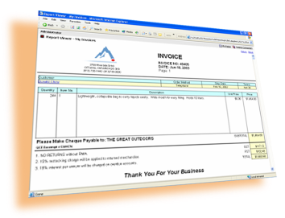
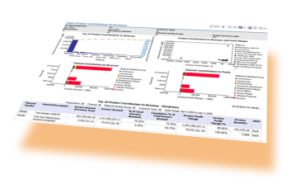
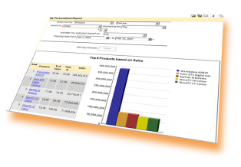
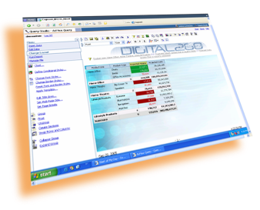
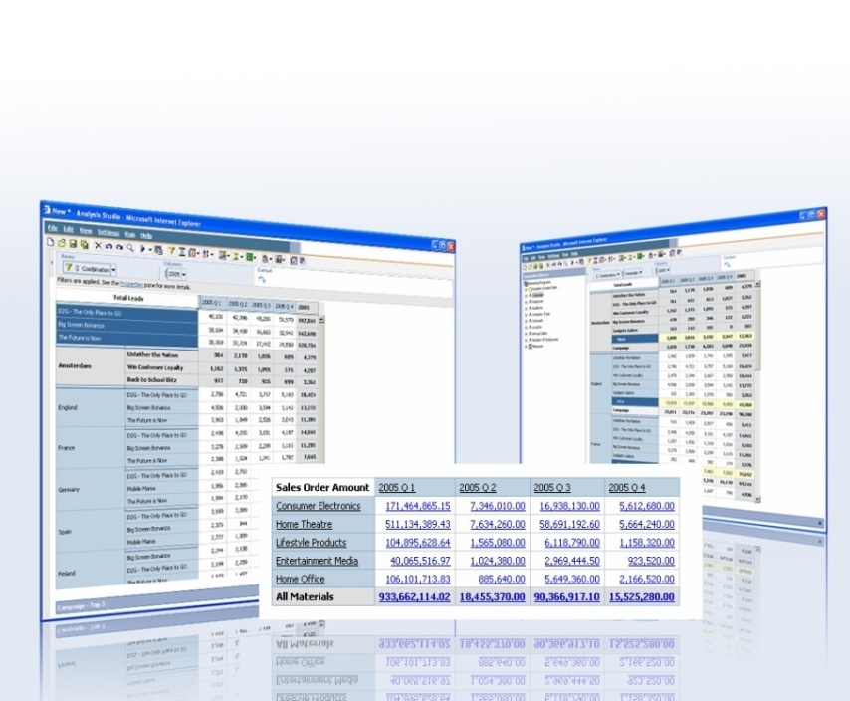
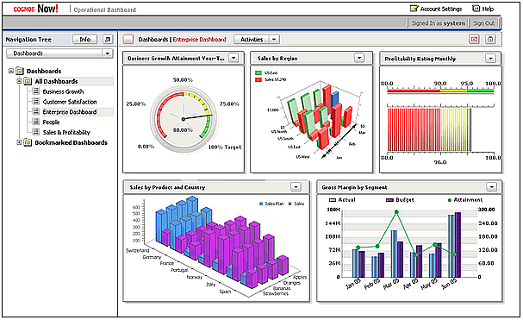
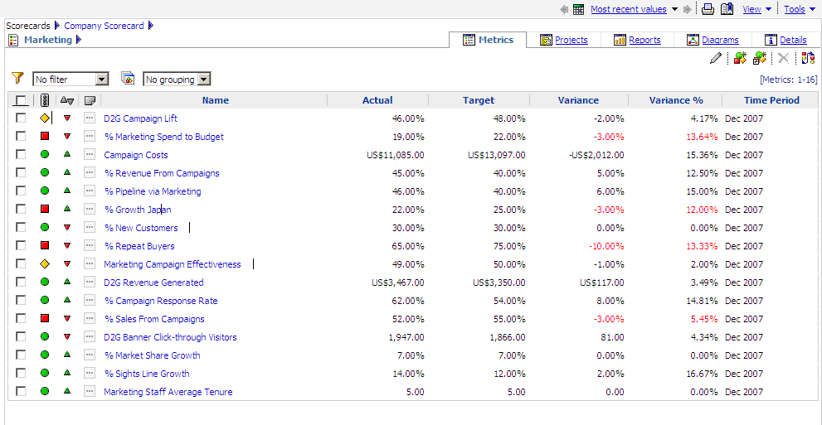
Overview of Cognos Capabilities
Reporting
Provides full breadth of report types
Delivers consistent information across all types of report output
Can be personalized and targeted
Enables collaboration across users, communities and with IT
Provides access via email, portal, MS-Office, search and mobile devices etc
Analysis
Provides guided exploration across multiple dimensions of information
Performs complex analysis and scenario modeling easily and quickly
Gets to the “why” behind trends to reveal symptoms and causes
Moves from summary level to detail levels of information effortlessly
Dashboards
Provides at-a-glance, high impact views of complex information
Helps quick focus on issues that need attention and action
Are highly visual and intuitive
Combines information across disparate sources
Scorecards
Provides instant measurement relative to targets and benchmarks
Aligns decisions and tactics with strategic initiatives
Supports scorecarding methodologies
Ensures ownership and accountability

Slide 12








How Does Cognos Work?
End Users
eg. desk based, mobile
Data Security
eg. data by user, group, all
IBM
Cognos BI
Framework
Manager
Output Formats
eg. PDF, HTML,
XML, XLS, paper
Databases
Informix
Netezza
DB2
Maximo
Other systems
  Oracle
Delivery Mechanisms
eg. web browser, email, mobile device
Other Data Files
(eg. Targets) such as Excel spreadsheets
Notes:
12

Slide 13
Demonstration

Slide 14
Agenda
What is Analytics?
Cognos Business Intelligence (BI)
SPSS Modeler
Summary
Why are organisations looking at Analytics?
Scope
What is it?
Overview of capabilities
How does it work?
What is it?
Overview of SPSS
Demonstration
Demonstration
Use Cases
Information

Slide 15
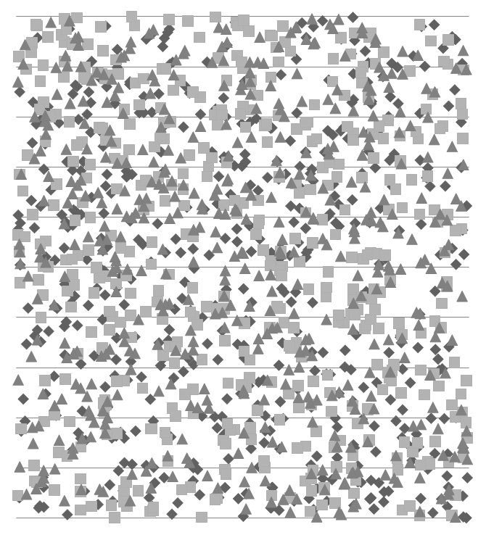
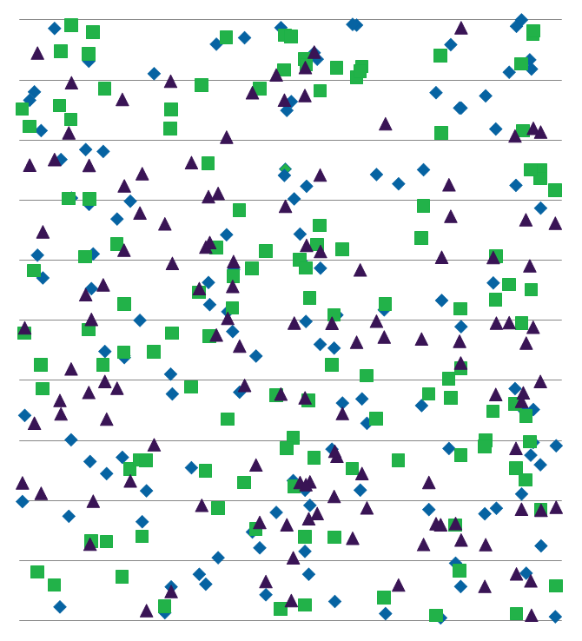
The Baseline of Predictive Analytics – Applied Mathematics
Statistics: Ask a Question of a Sample to Generalize to the Universe
A Sample of Data
A Universe of Things That Generate Data
?
Notes:
To explain SPSS solutions from a technology standpoint, let’s take it to its basics. SPSS solutions are all based on the principle of applied mathematics. Statistics originated in research environments to help people ask a question of a sample of data and generalize an answer to the universe of things which generate that data. So a survey on a sample of voters’ preferences could be generalized to the outcomes of an election.
At its core, SPSS Solutions are all based on this mathematics. Making predictions based on available data….

Slide 16
Getting a More Accurate Picture: All the Data Matters
High-value, dynamic
- source of competitive differentiation
Interaction data
E-Mail / chat transcripts
Call center notes
Web Click-streams
In person dialogues
Attitudinal data
- Opinions
Preferences
Needs & Desires
Survey results
Social Network Data
360 degree
View of Problem
Descriptive data
Attributes
Characteristics
Self-declared info
(Geo)demographics
Behavioral data
- Orders
- Transactions
Payment history
Usage history
“Traditional”
Notes:
The more data you have, the better your predictions can be. The data which is important comes in four categories. Most clients have traditional data stored in datamarts or operational data stores. This data includes basic behavioral data like orders and payments but usually also includes descriptive data like demographics, and other “dimensions” commonly found in BI environments.
<Click>
The high value data we are seeing clients add into the mix is attitudinal data and interaction data. This non traditional data includes the opinions and preferences of customers, often in form of open ended survey results or even as feedback gathered in Social Media. Coupling this with the results of real time Interaction data like verbatim chat transcripts and web click streams hones the insights provided from the data significantly.

Slide 17

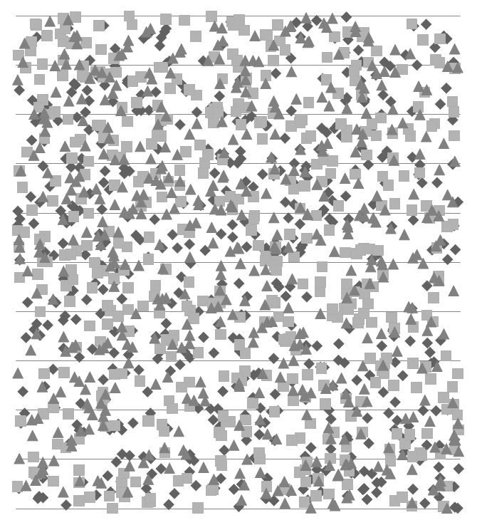
Taking Predictive Analytics to the Next Level
Data Mining: Predict the Behavior of the Next Case with a Model
A Universe of Data
A Predictive Model
Attributes:
Married, 1 kid
Lives in Suburbs of Chicago
Owns two Cars
39 years old
Drinks Scotch
Predicted Attributes
Likes Guns n Roses
Likes Johnnie Walker Black
Works long hours
Commutes
Upper Middle Income
Predicted Behavior
Wants to Buy a Sportscar!
Buys Car Washes!
Buys Chardonnay
Vacations where it’s warm
Notes:
The more data you add the richer your predictions get. But the problem with traditional analytic techniques is that it counts on the human to ask the question. The science of data mining points a machine at ALL of your data and letting it FIND what is interesting. It takes all the data and groups it into things that “look similar” and embodies them in what is called a predictive model. This mathematical formula basically has the ability to predict attributes of your next case based on knowing just a little about it. It’s sort of like a vending machine: you put a few attributes in and a whole series of predicted attributes and behaviors comes out.
<NOTE – CUSTOMIZE THIS FOR YOURSELF>
So, let’s say we pointed our predictive analytics at a bunch of customer data – and the system built a model which was now going to be applied to me. We might feed into the system things like the fact that I’m married, that I have 1 daughter, that I live in Chicago, amd 39 years old and I like to drink scotch.
From those few bits of information the model could predict things about me. For example, it might say “well since you’re 39 you’re middle aged, so you probably like big hair 80s heavy metal bands. And you live in the suburbs where it’s cold in the winter, and since it’s now the winter time, it would make sense to offer you a warm vacation spot. Also, you like to drink scotch and have two cars… you’re obviously decently well off so you probably like a decent scotch like Johnnie Walker Black – but not too over the top because you don’t live in a highrise in the city. Also, you’re married so the next time you come into the store we should offer you a coupon on Chardonnay because you probably like to have a coctail with your wife on Friday, and she probably likes wine.”
See what it does? It take a few attributes and predicts things about me. Now this example was made up, but what you can do is have the system predict things about your customers, or your employees etc. What makes someone decide to leave? What is the best cross sell offer to make. The predictions are there… now we need to apply them…

Slide 18
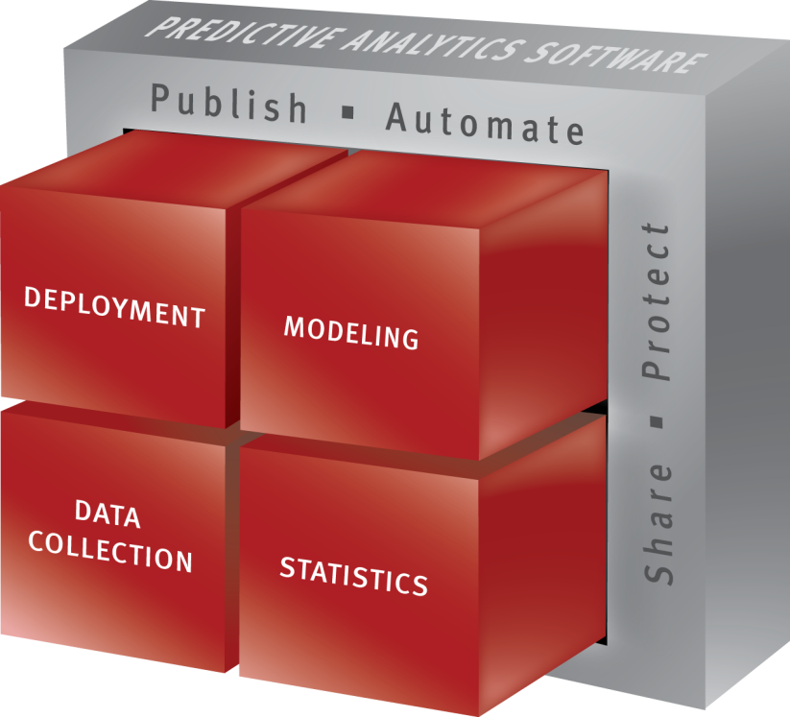
SPSS Product Overview

Slide 19
Driving Smarter Business Outcomes
Capture
Predict
Act
Data Collection delivers an accurate view of customer attitudes and opinions
Predictive capabilities bring repeatability to ongoing decision making, and drive confidence in your results and decisions
Unique deployment technologies and methodologies maximize the impact of analytics in your operation
…
Text
Mining
Data
Mining
Statistics
Data
Collection
Deployment
Technologies
Platform
…
Attract
Up-sell
Retain
Enabling customers to predict future events & proactively act upon that insight to drive smarter business outcomes
Page 19

Slide 20
Demonstration

Slide 21
Agenda
What is Analytics?
Cognos Business Intelligence (BI)
SPSS Modeler
Summary
Why are organisations looking at Analytics?
Scope
What is it?
Overview of capabilities
How does it work?
What is it?
Overview of SPSS
Demonstration
Demonstration
Use Cases
Information

Slide 22
Use Cases
Customer
Churn
Fraud
Detection
Cashflow
Predictions
Student results/attrition
Employee
Analysis
NEET
Smart Metering
Store
Location
Analysis
Market
Basket
Analysis
Asset
Maintenance

Slide 23
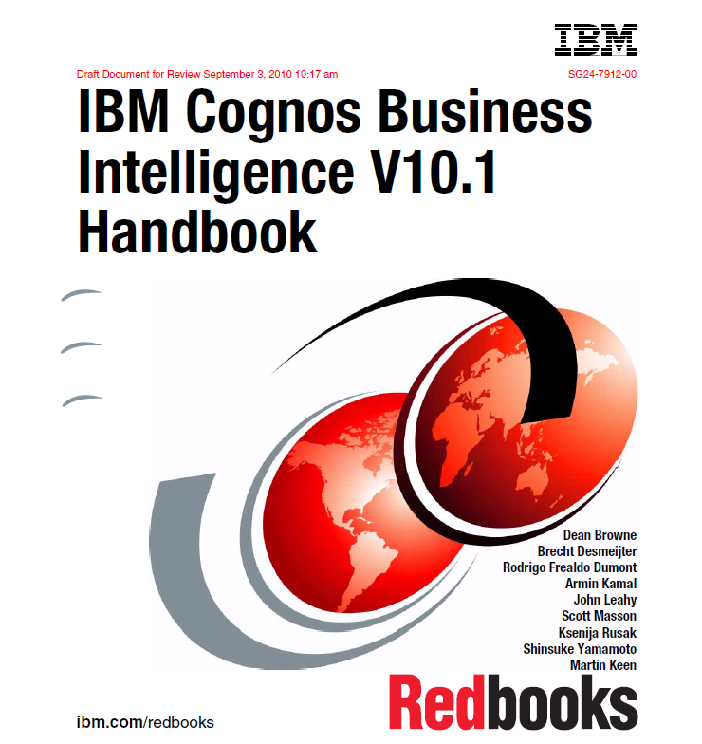
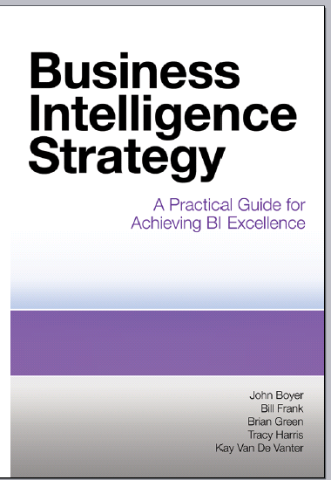
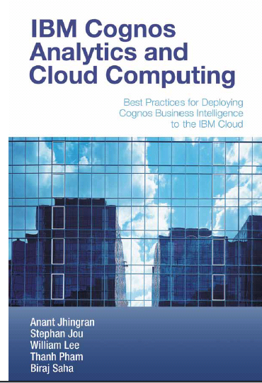
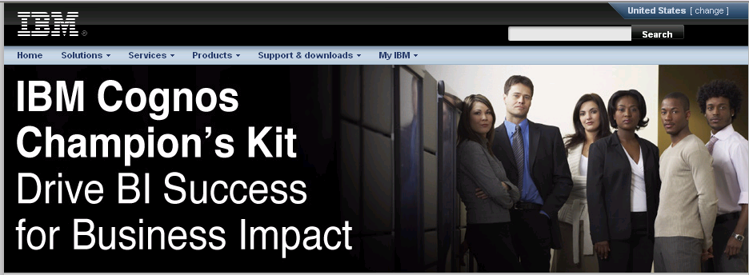
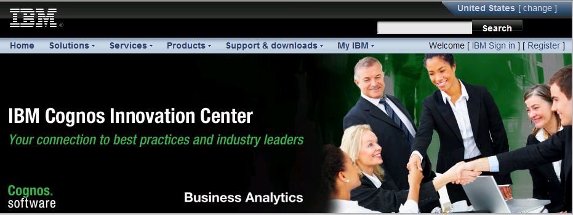
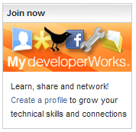



Information and Support
New “How-to” Books Deliver Expertise
  BI Strategy Book, BI on Cloud, BI Redbook
Proven Practices, Communities & Workshops
  Champion & Business Analytics Workshops
  Innovation Center & Communities
  Champion Kit, Blueprints
  DeveloperWorks, C^3 Blog
Services & Training
  Proven Practice Workshops, Learning Assessment and User Adoption Services
  Broader portfolio of self-paced training options
Broader Deployment Options
  Expanded offering for System z
  On IBM Compute Cloud
  http://www.analyticszone.com
  http://www.ibm.com/developerworks/
  http://www.redbooks.ibm.com/
Notes:
BA Cognos 10 Template
6/25/2014
Prensenter name here.ppt
23

Slide 24

Questions?
?
?
?

Slide 25

© Copyright IBM Corporation 2011 All rights reserved. The information contained in these materials is provided for informational purposes only, and is provided AS IS without warranty of any kind, express or implied. IBM shall not be responsible for any damages arising out of the use of, or otherwise related to, these materials. Nothing contained in these materials is intended to, nor shall have the effect of, creating any warranties or representations from IBM or its suppliers or licensors, or altering the terms and conditions of the applicable license agreement governing the use of IBM software. References in these materials to IBM products, programs, or services do not imply that they will be available in all countries in which IBM operates. Product release dates and/or capabilities referenced in these materials may change at any time at IBM’s sole discretion based on market opportunities or other factors, and are not intended to be a commitment to future product or feature availability in any way. IBM, the IBM logo, Cognos, the Cognos logo, and other IBM products and services are trademarks of the International Business Machines Corporation, in the United States, other countries or both. Other company, product, or service names may be trademarks or service marks of others.
Notes:
25
Closing slide to be included in all external presentations.

Slide 26


